Slide 1
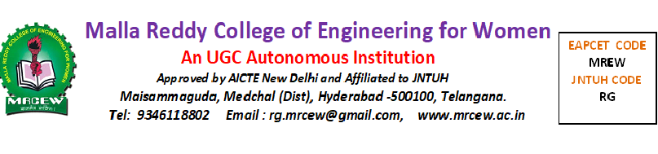
DEPARTMENT OF COMPUTER SCIENCE AND ENGINEERING
SECURE DATA TRANSFER AND DETECTION FORM COUNTING BLOOM FILLER COMPLETE DOCUMENTS
PRESENTED BY:
N.SAI SRI HARSHITHA 21RG1A05A4
P.KAVYA 21RG1A05B4
Y.SINDHU 21RG1A05D0
K.SANGEETHA 21RG1A0590
UNDER THE GUIDENCE OF:
Mr V SHYAM KUMAR

Slide 2

CONTENTS
Abstract
Introduction
Existing System
Literature Survey
Proposed Method
Hardware & Software Requirements
Advantages
Applications
Result Analysis
Future Scope
Conclusion
References

Slide 3

ABSTRACT:
As cloud storage grows, users often move their data between providers for better service.
This makes secure data transfer and permanent deletion very important.
We propose a new method using counting Bloom fillers to ensure both, with public verification and no need for a trusted third party.
Our tests show it's both practical and efficient.

Slide 4



INTRODUCTION:
Cloud computing offers flexible storage services, allowing users to store and manage data remotely.
Asusers switch between providers, secure data transfer and deletion become essential.
However, issues like data loss, incomplete transfer, and hidden data retention pose risks.
To solve this, we propose a counting Bloom filler-based method that ensures secure, verifiable transfer and deletion without needing a trusted third party.

Slide 5

EXISTING SYSTEM:
Previous methods support verifiable data deletion using techniques like encryption, Merkle Hash Trees, and even Blockchain.
However, most rely on a trusted third party (TTP) and cannot ensure secure data
DISADVANTAGES OF EXISTING SYSTEM
No proof of data integrity during transfer.
Weak encryption leading to lower performance.

Slide 6

PROPOSED SYSTEM:
We introduce a Counting Bloom Filler-based method to ensure both secure data transfer and verifiable deletion between cloud servers.
It allows users and the new cloud provider to check if data was fully and honestly moved or deleted all without needing a trusted third party.
Tests prove it’s secure, efficient, and practical.
ADVANTAGES OF PROPOSED SYSTEMS:
Data confidentiality: Files are encrypted to keep them private.
Data integrity: Verifies that all data is transferred correctly.
Public verifiability: Anyone can check if data was moved or deleted properly.

Slide 7
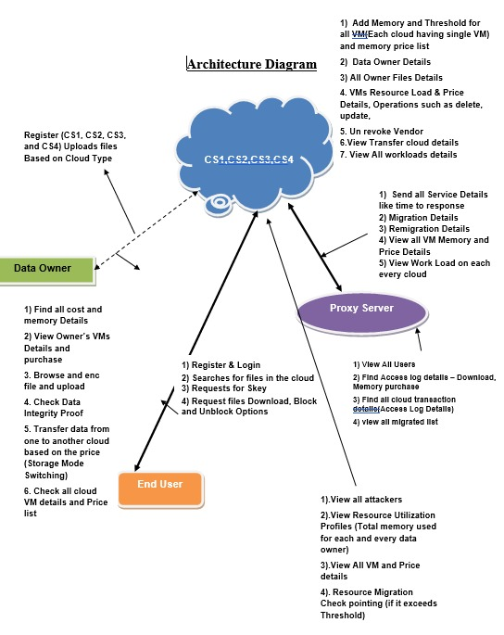
SYSTEM ARCHITECTURE:

Slide 8
DETAILS OF DIAGRAM:
CS1 ---- Rackspace CS2 ---- Amazon S3 CS3 ---- Windows Azure CS4 ---- Aliyun OSS
PRICE MEMORY
2000 18000 6000 40000 8000 1000000

Slide 9
REQUIREMENTS
HARDWARE REQUIREMENTS:
CPU: Intel i5 / Ryzen 5+
RAM: 8 GB+
Storage: 256 GB SSD
Server:Quad-core CPU, 16 GB RAM, 500 GB SSD
Peripherals: Scanner or camera for form input
SOFTWARE REQUIREMENTS:
OS: Windows 10/11, Linux (Ubuntu), or macOS.
Languages: Python 3.8+, optional Java/C++.
Libraries: Secure Transfer: OpenSSL, PycryptoDome, Flask/Django.
Bloom Filter: Pybloom, bloom-filter2.
Detection/Counting: OpenCV, Tesseract OCR.
Database: MongoDB / PostgreSQL / SQLite.
Tools: VS Code / PyCharm, Git, Postman, Docker.

Slide 10
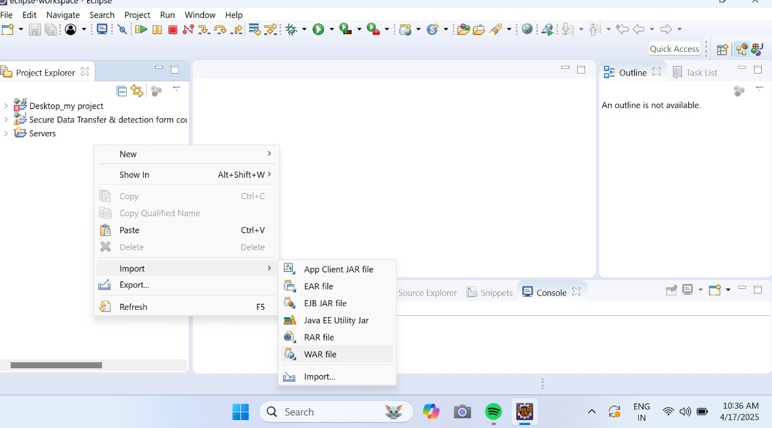
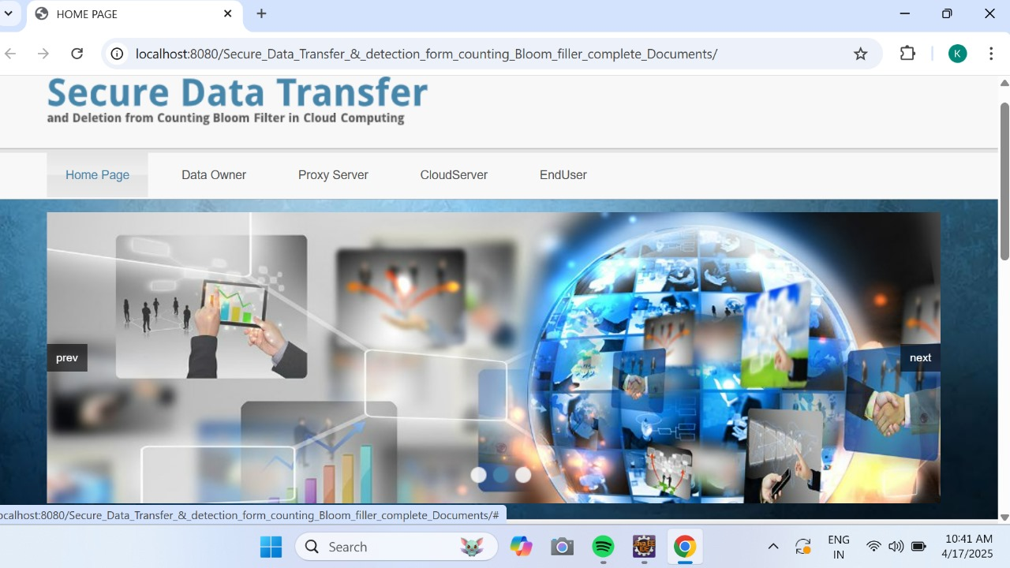
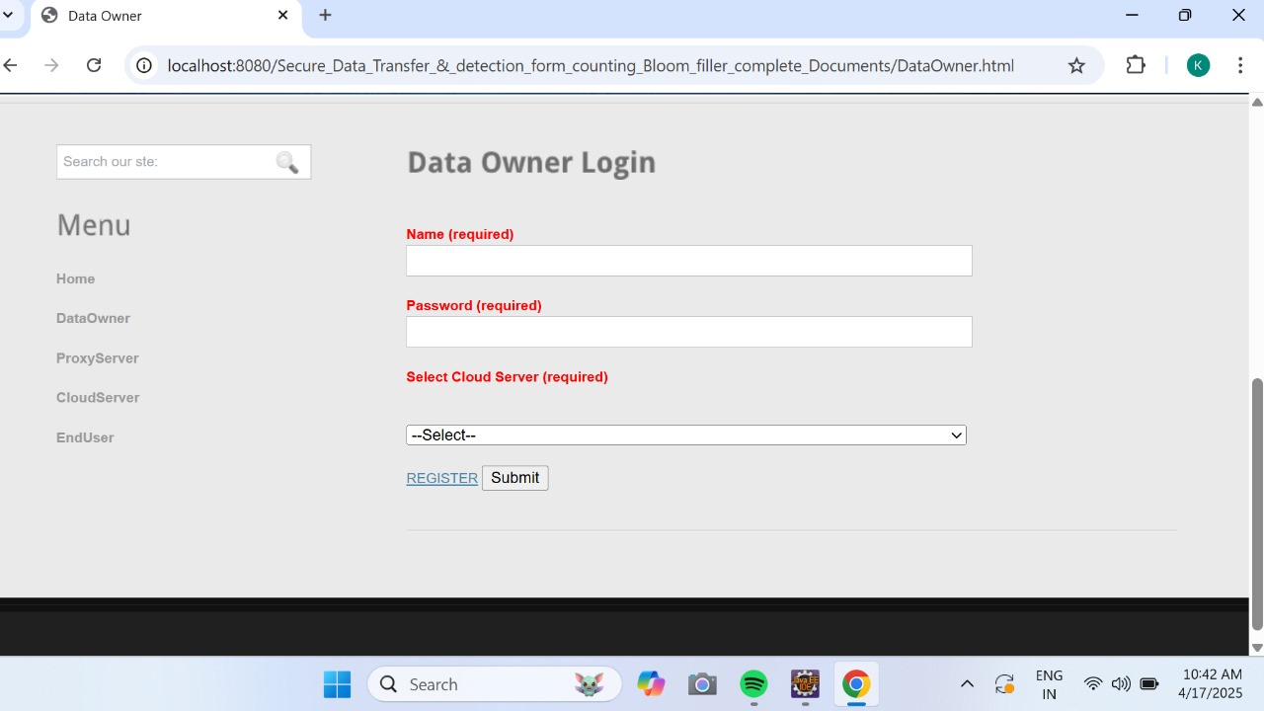
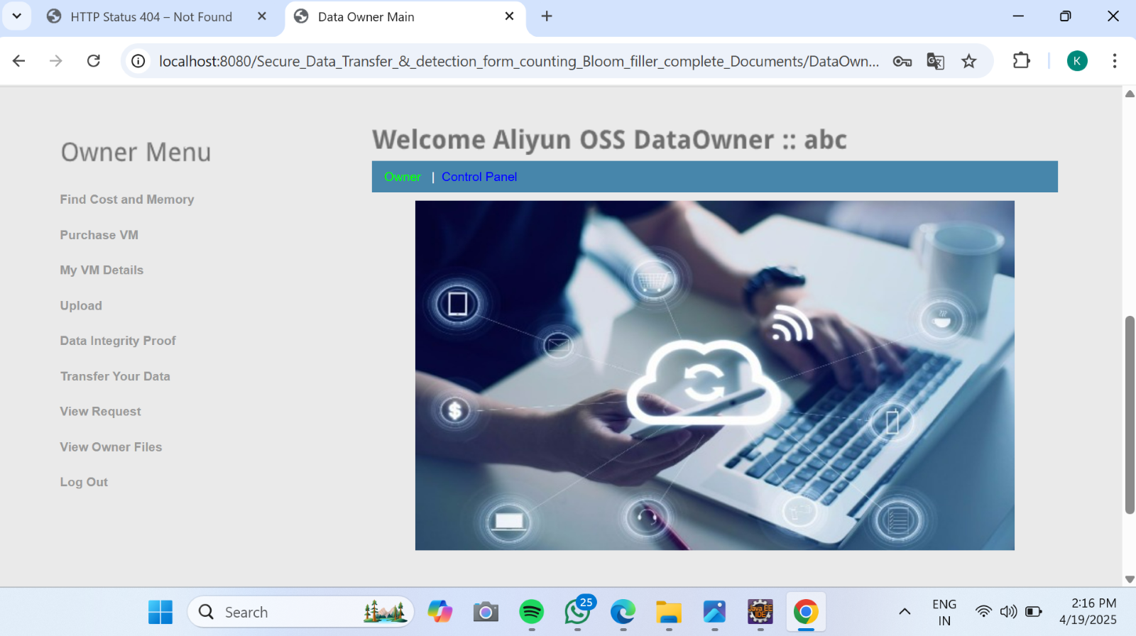
RESULT ANALYSIS

Slide 11
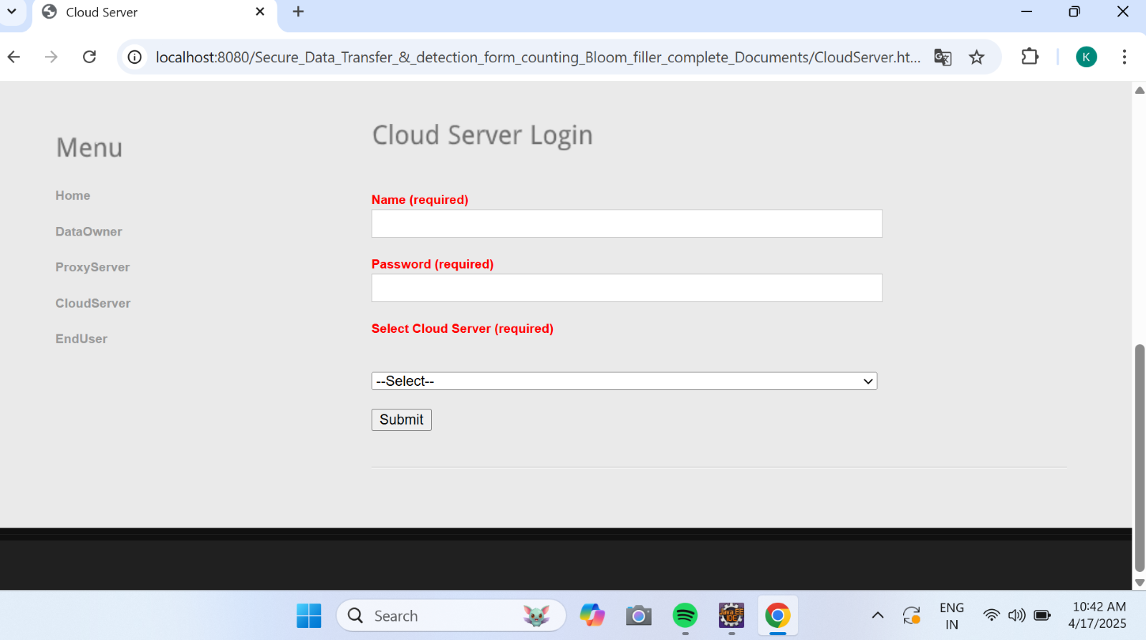
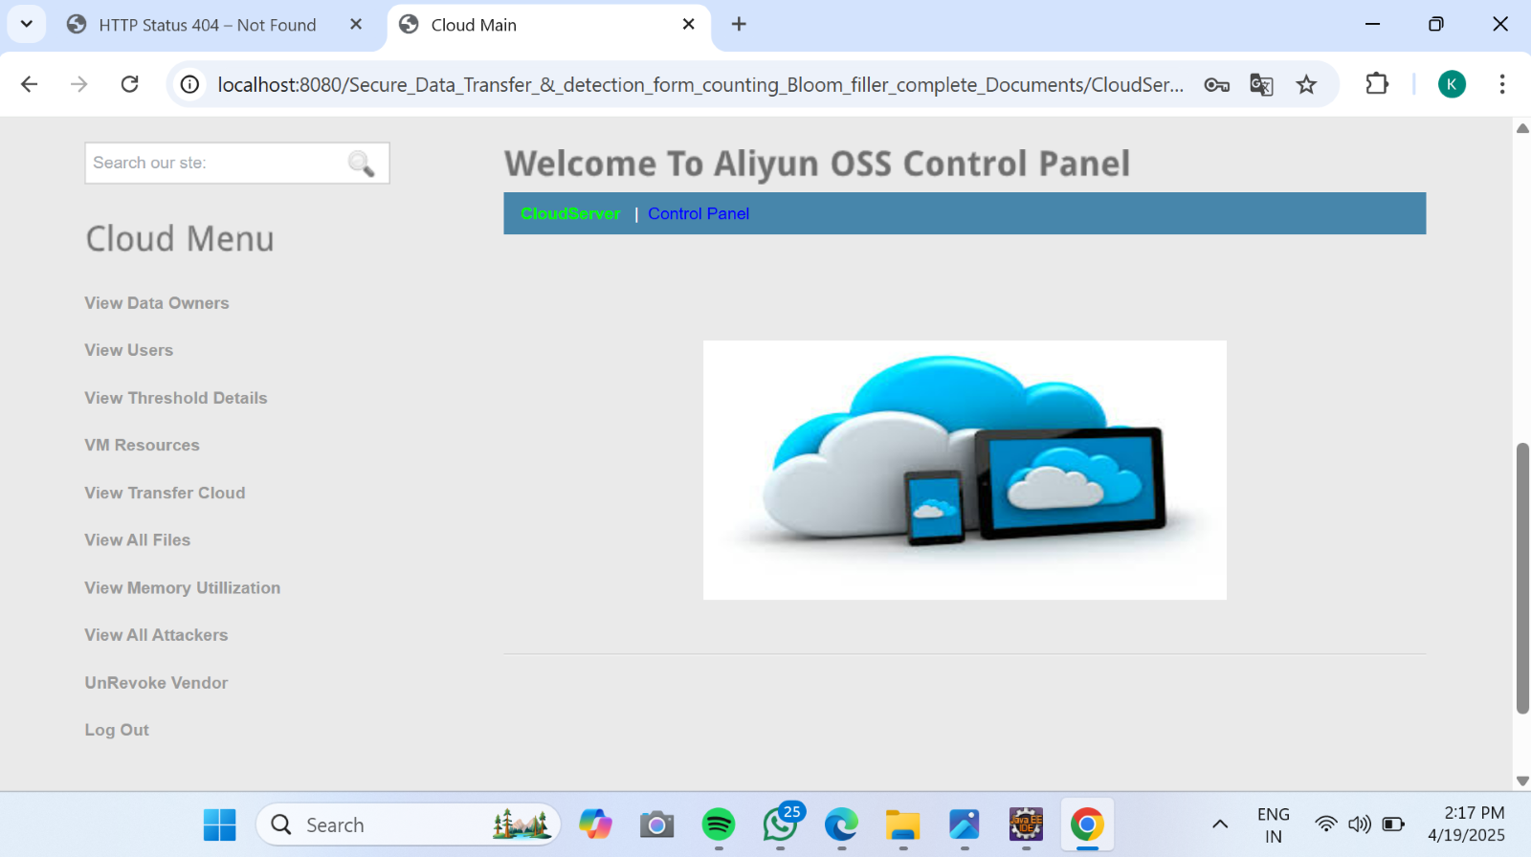
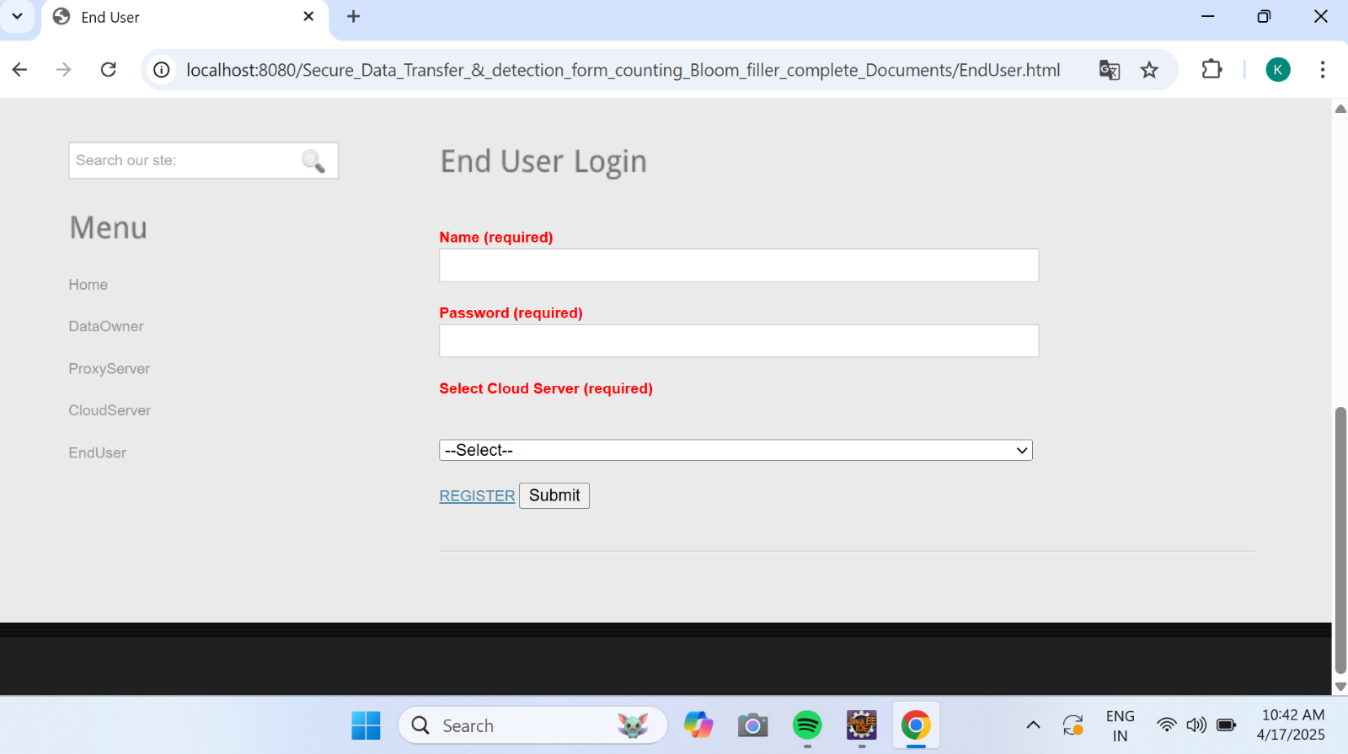

Slide 12
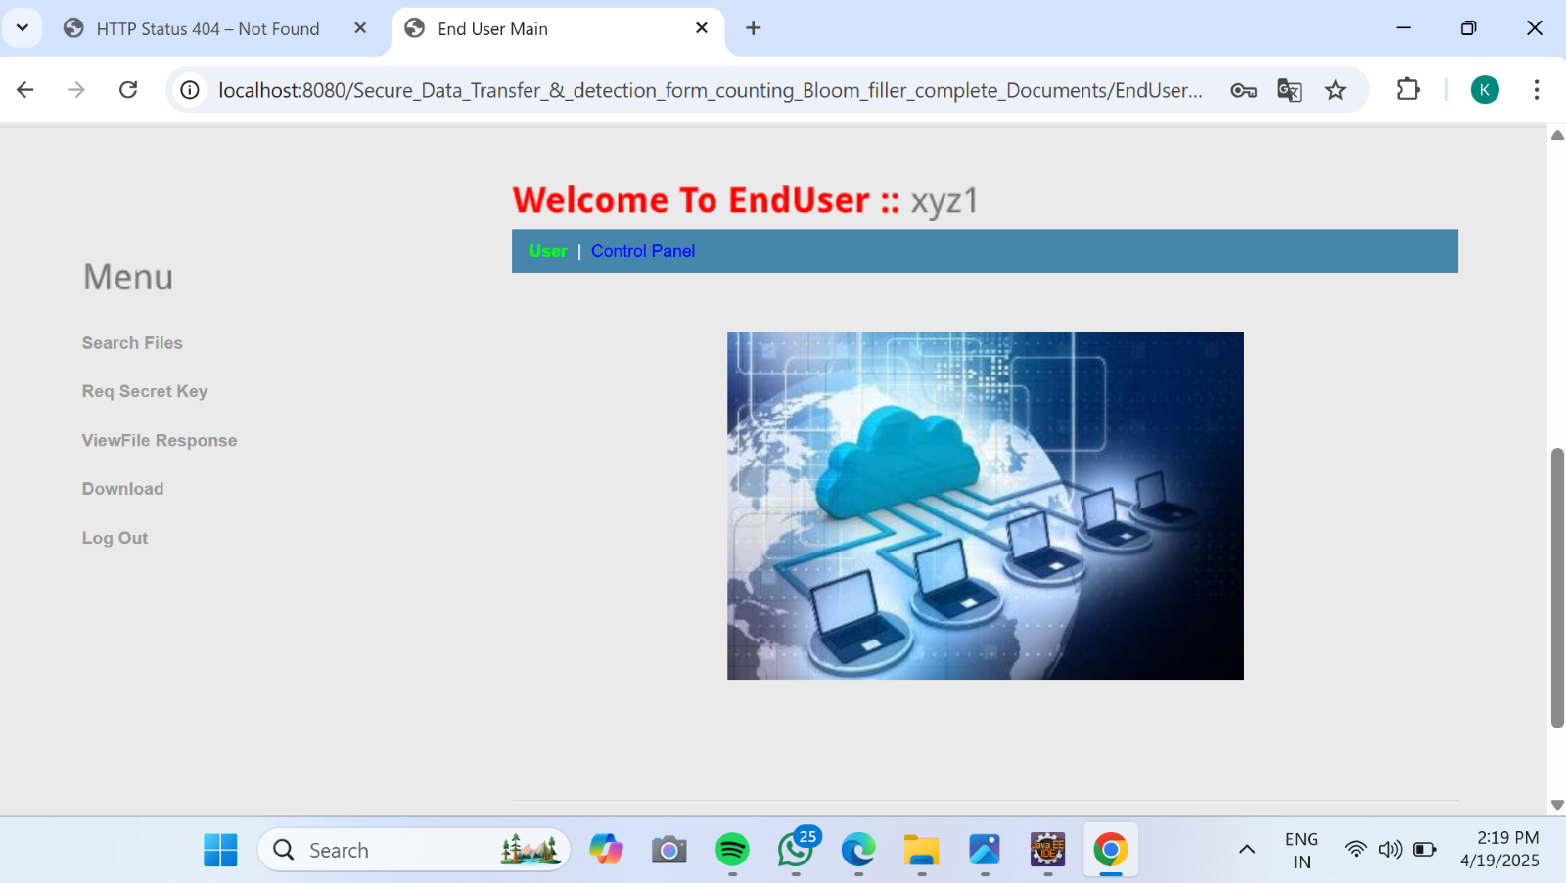
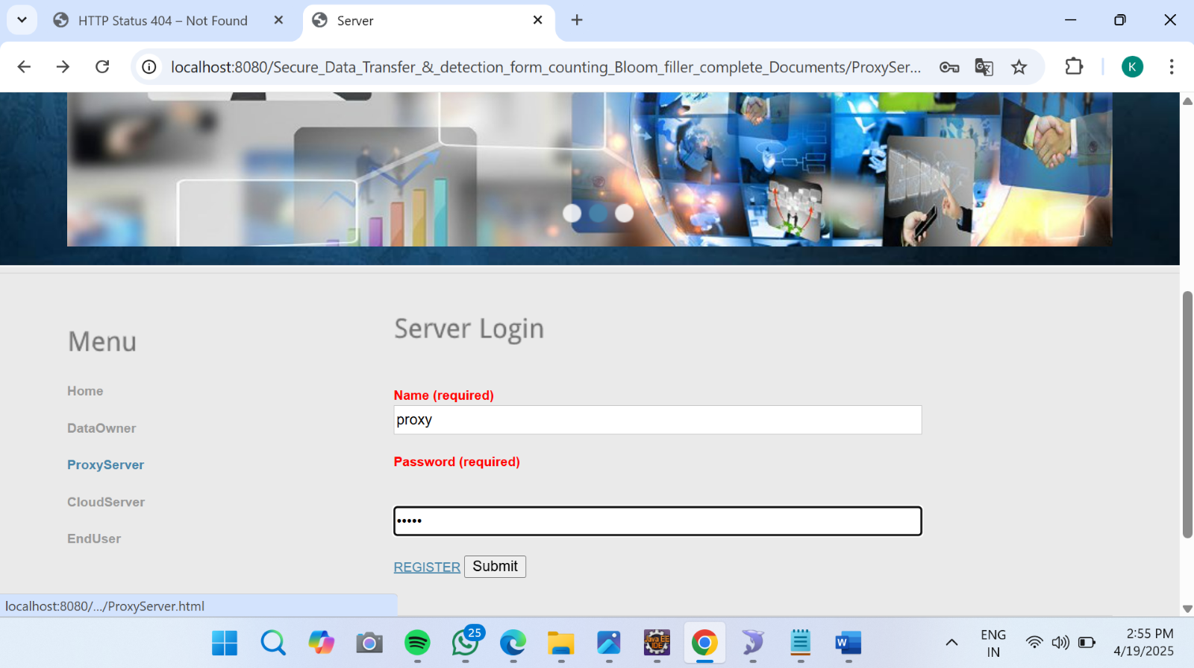
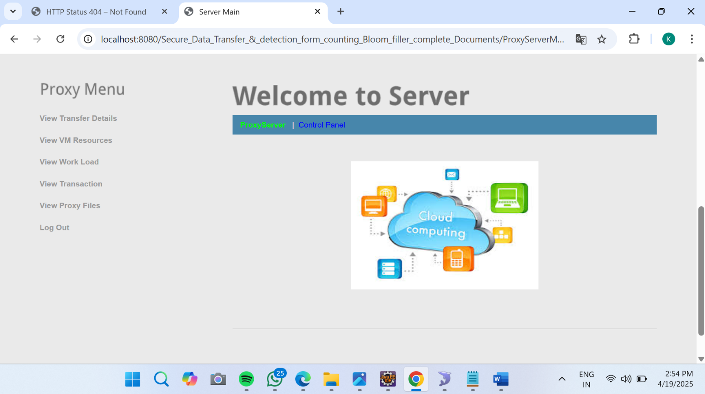

Slide 13
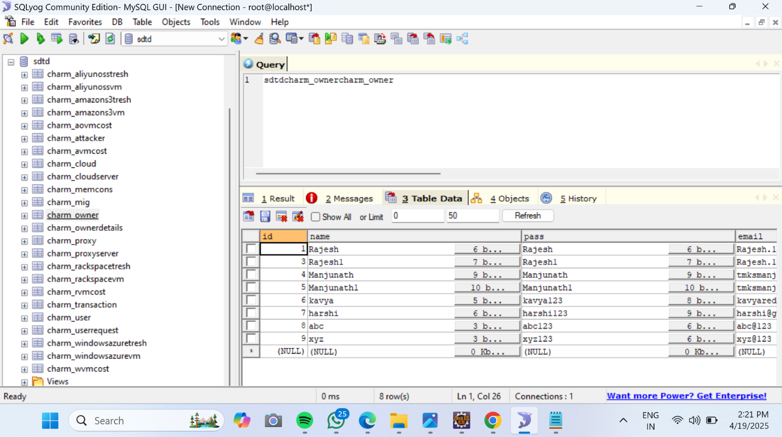
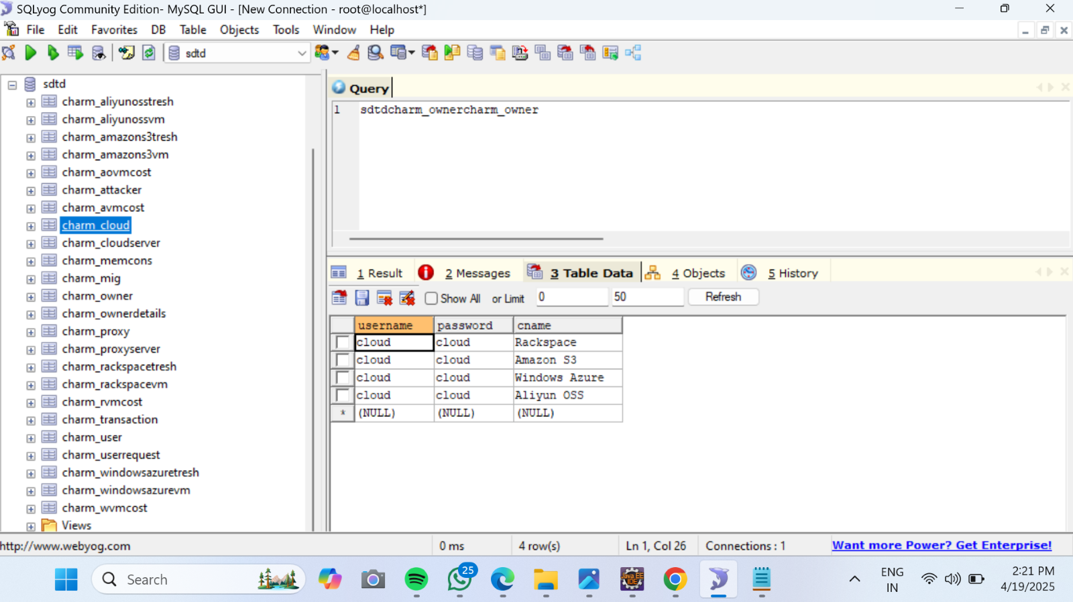
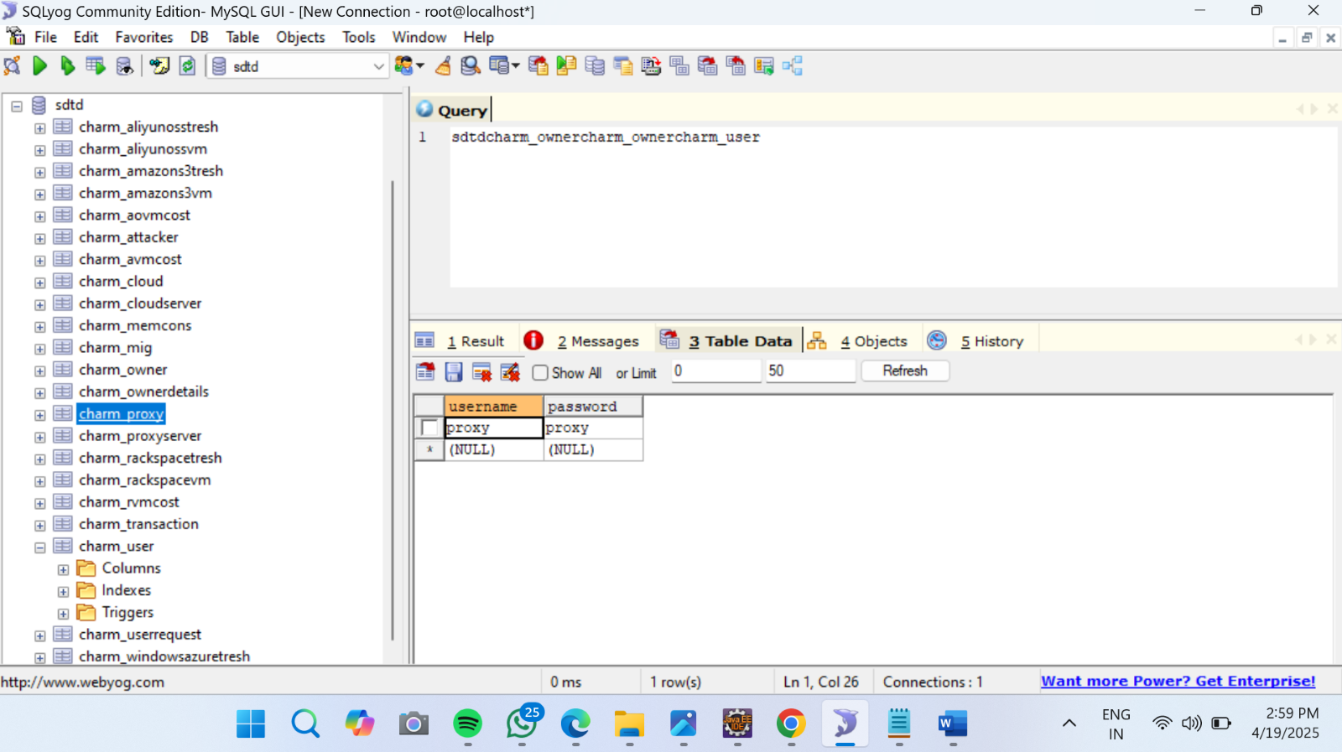

Slide 14
ADVANTAGES
Efficient Data Verification : Counting Bloom Fillers allow for fast and memory-efficient checking of whether a document has been received or not.
Space Optimization : Bloom fillers use less memory compared to storing full document hashes or file content for verification.
Secure Transmission : Integrating secure protocols ensures data is transmitted without interception or tampering.
Duplicate Detection : Helps identify and eliminate duplicate documents during transfer, saving bandwidth and storage.
Reduced False Positives : Counting Bloom Fillers improve upon standard Bloom Filters by allowing deletion and minimizing false positives.

Slide 15
APPLICATIONS
Cloud Data Synchronization : Ensures only missing or updated documents are transmitted between clients and servers.
Distributed File Systems:Used in peer-to-peer networks or content delivery networks to check for file availability.
Email and Messaging Systems : For detecting whether an attachment has already been sent/received without needing the full file.
Cybersecurity : Used to detect malicious files or prevent data exfiltration by checking for known file signatures.
Database Management : Efficiently determine which records or documents need to be updated or added.

Slide 16
CONCLUSION
In cloud storage, data owners may not trust that providers handle transfers or deletions honestly.
To address this, we proposed a Counting Bloom Filler (CBF)-based scheme that ensures secure data transfer and verifiable deletion.
Cloud B can check data integrity, and Cloud A must provide proof of deletion. This prevents cheating and ensures trust.
Security analysis and tests confirm our method is both safe and practical.

Slide 17
FUTURE SCOPE
Integration with Blockchain: Combine with blockchain for an immutable and secure log of file transfers and verifications.
AI-Driven Optimization: Use machine learning to dynamically adjust filter sizes or thresholds to reduce false positives/negatives.
IoT and Edge Devices: Ideal for lightweight verification in low-power or low-storage devices.
Enhanced Security Layers: Incorporate homomorphic encryption or secure multi-party computation for privacy-preserving verification.
Scalability to Big Data Systems: Can be scaled to handle terabytes of data efficiently in data lakes or data warehouses

Slide 18
REFERENCE
1.B. H. Bloom, “Space/Time Trade-offs in Hash Coding with Allowable Errors,” Communications of the ACM, vol. 13, no. 7, pp. 422–426, 1970.[Original Bloom Filter Paper]
2. Li Fan, Pei Cao ,Jussara Almeida, and Andrei Z. Broder, "Summary Cache: A Scalable Wide-Area Web Cache Sharing Protocol", IEEE/ACM Transactions on Networking, 1998.[Discusses Bloom filter use in web caching]
3. Jingwei Li, Zhenyu Wu, et al., "Efficient Deduplication with Counting Bloom Filter for Secure Cloud Storage", Proceedings of the 2017 IEEE Conference on Communications and Network Security (CNS), 2017.[Use of Counting Bloom Filters in secure cloud storage]
4. Xiaoyan Shen, Zheng Yan, and Robert H. Deng, "Bloom Filter-Based Secure and Privacy-Preserving Outsourcing of Big Data in Cloud", IEEE Access, vol. 6, pp. 5208–5217, 2018.[Privacy-preserving data handling with Bloom filters]
5. A. Broder and M .Mitzenmacher, "Network Applications of Bloom Filters: A Survey", Internet Mathematics, vol. 1, no. 4, pp. 485–509, 2004.[Comprehensive survey on Bloom filter applications]
6. William Stallings, "Cryptography and Network Security: Principles and Practice", 7th Edition, Pearson, 2017.[General reference for secure data transfer methods]
7. RFC 5246 - The Transport Layer Security (TLS) Protocol Version 1.2, IETF.[Standard secure protocol used in data transfer]

Slide 19


